Slide 1
IMDb Top 250 Movies Analysis
Jonathan Murphy
Stanley Yanis
Brianna Joseph
Joseph Haas

Slide 2
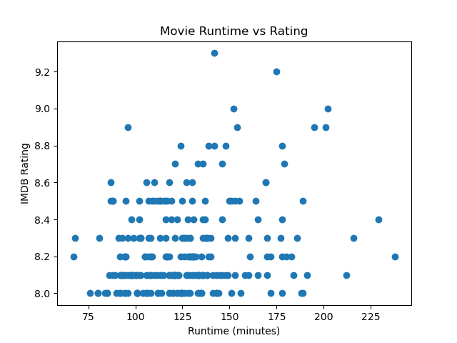
Movie Runtime vs Movie Rating:
Statistics show there is a slight positive relation

Slide 3
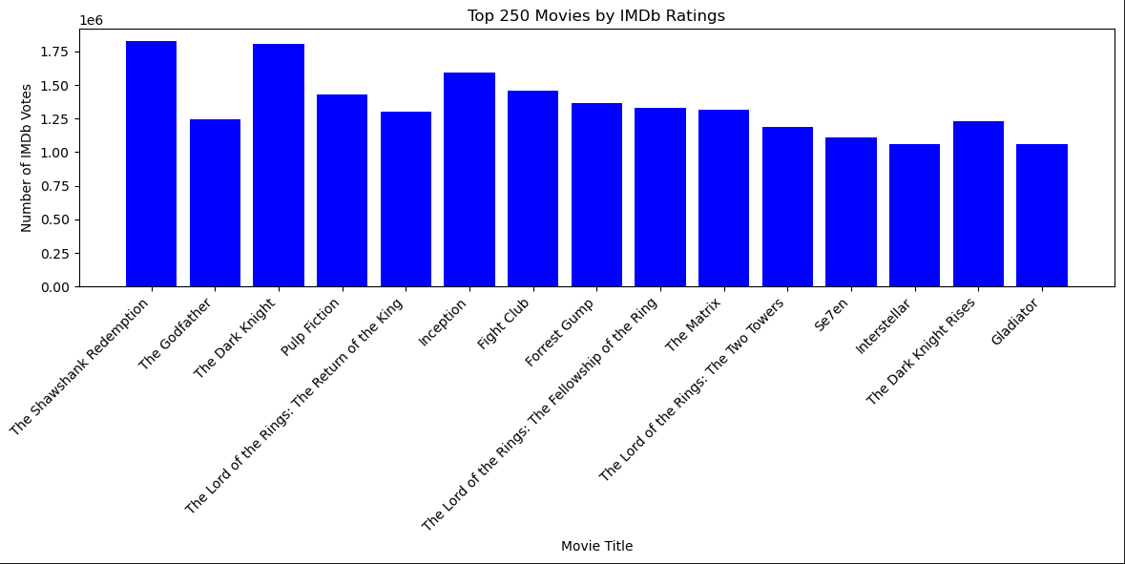
IMDb Votes vs Ratings:
Statistics show that there is a significant positive relation

Slide 4
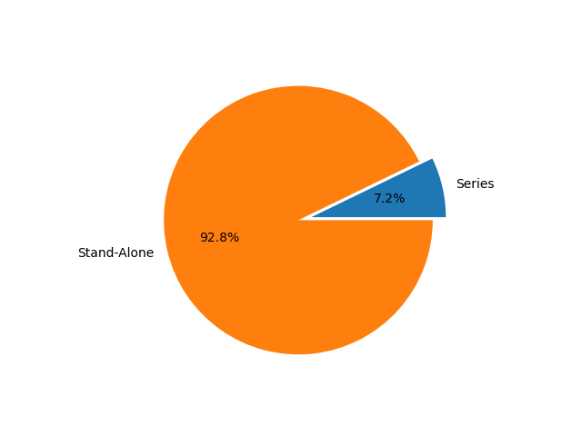
Movies within series

Slide 5
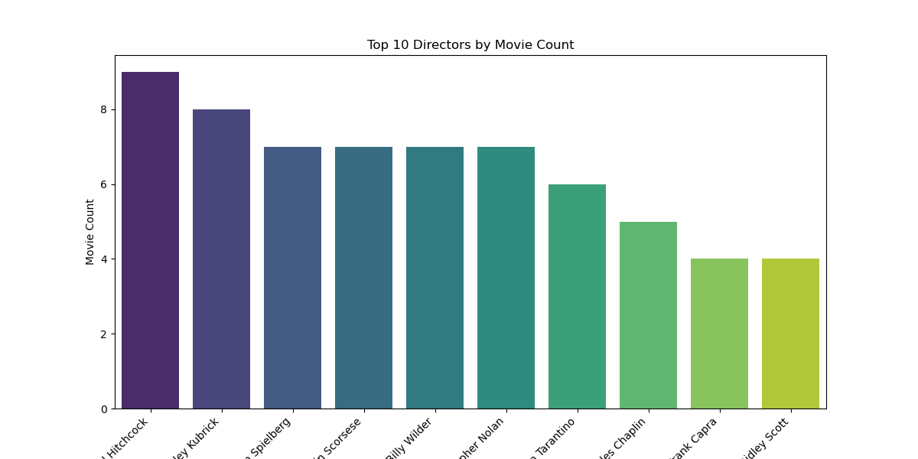

Slide 6
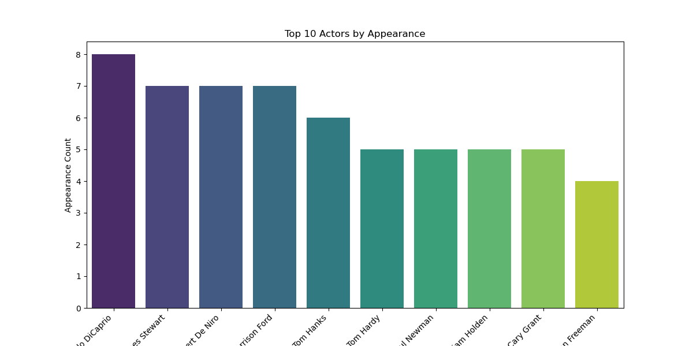

Slide 7
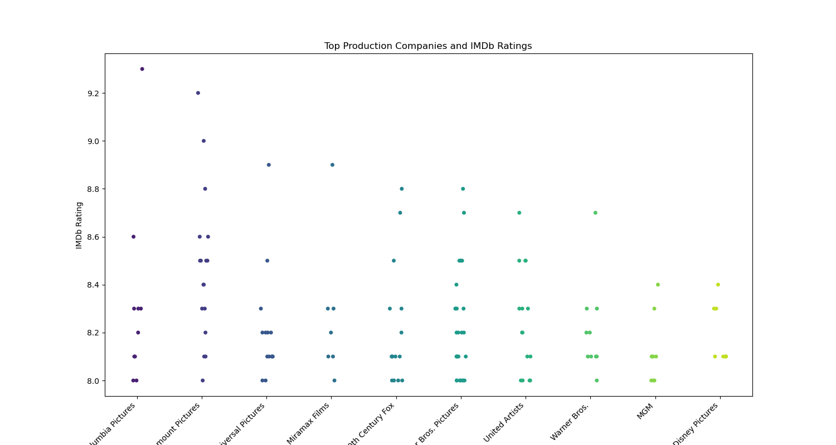

Slide 8
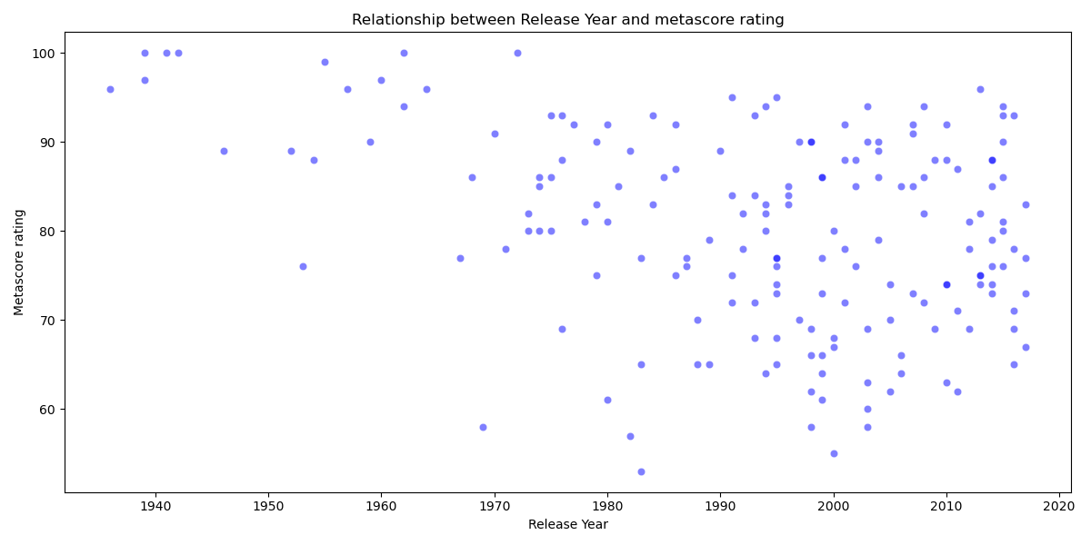
How does release year correlate with Metascore ratings?

Slide 9
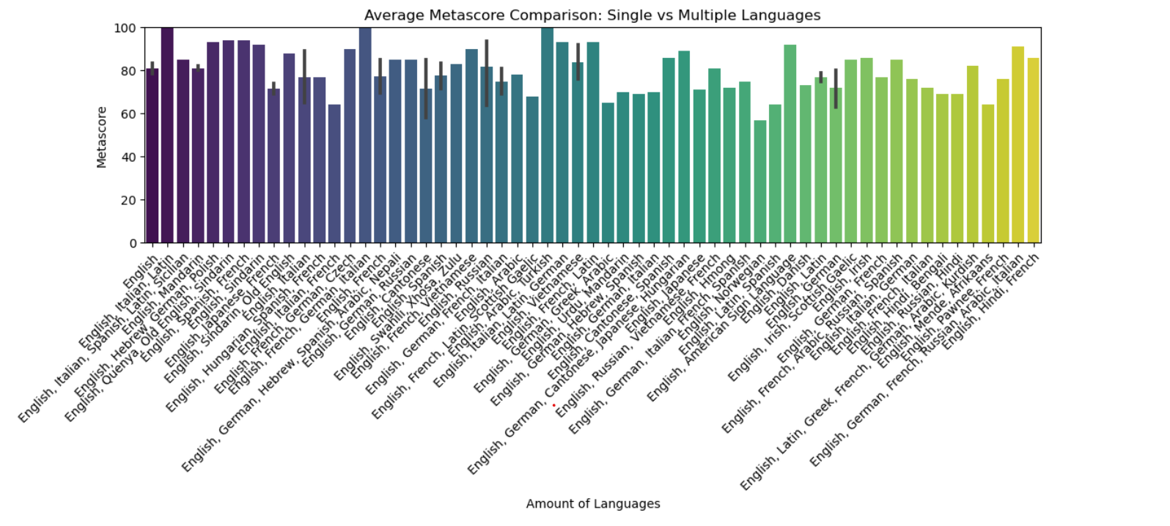
Do movies with more languages have a higher metascore rating in the top 250 vs single language movies?

Slide 10
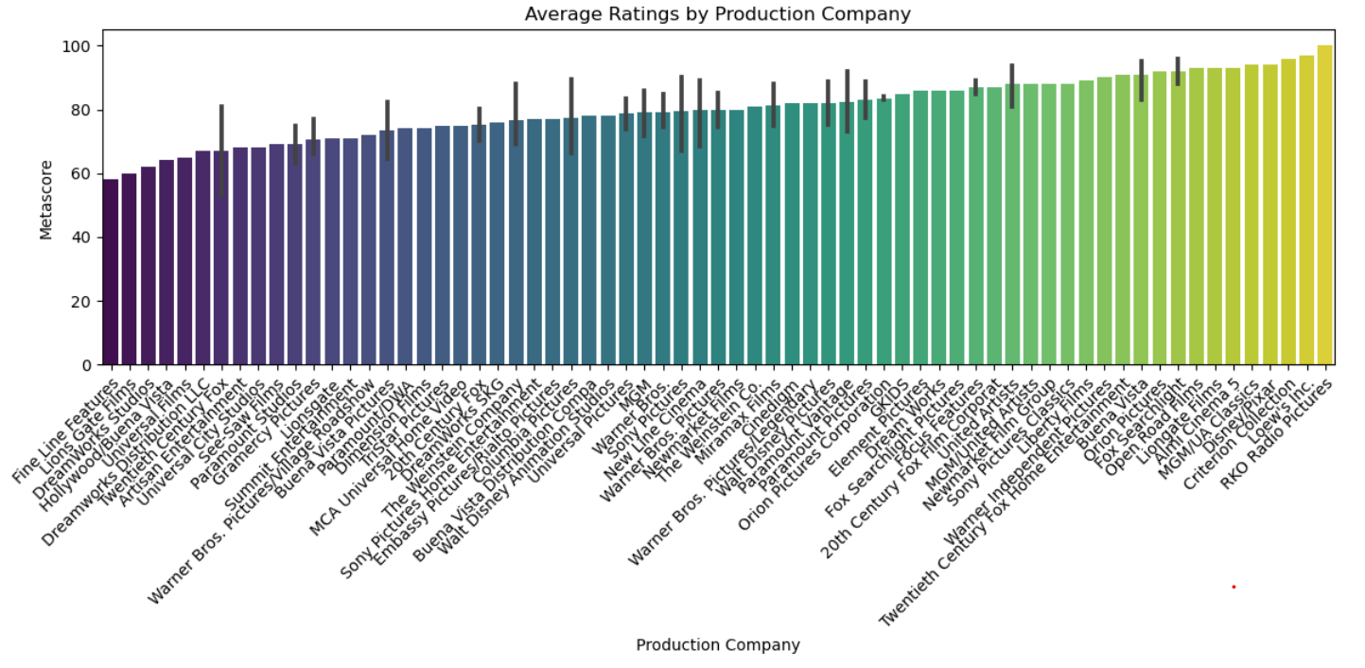
Which production companies create the highest rated films?

Slide 11
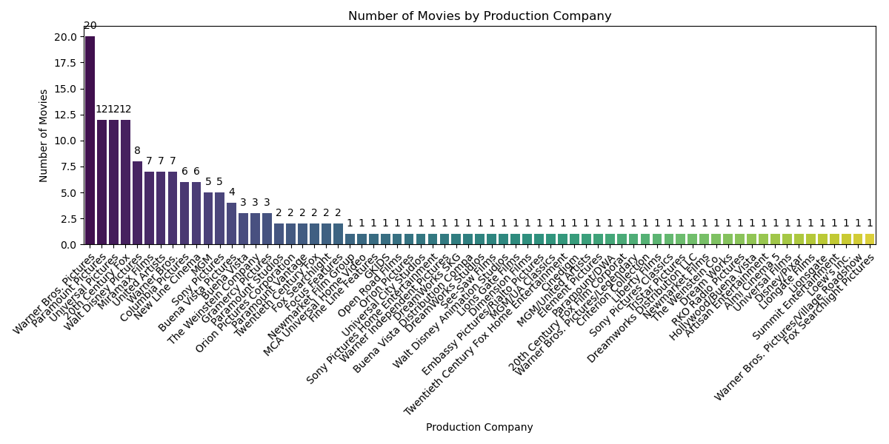
Which production companies create the highest rated films?

Slide 12
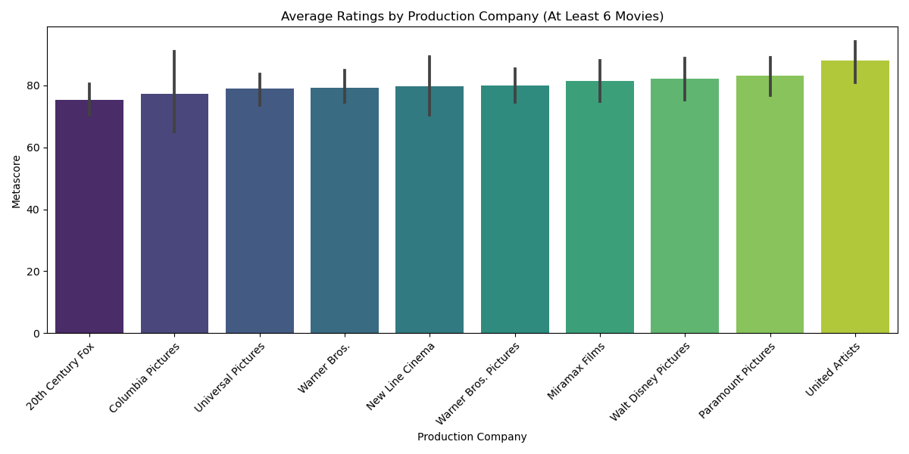
Which production companies create the highest rated films?

Slide 13
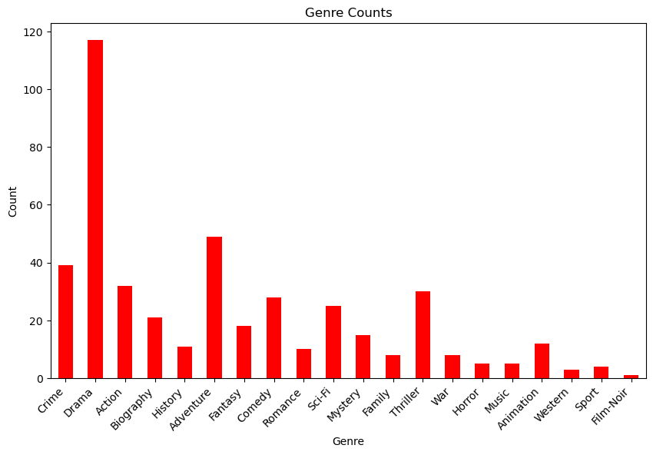
Does genre affect viability to make the top 250?

Slide 14
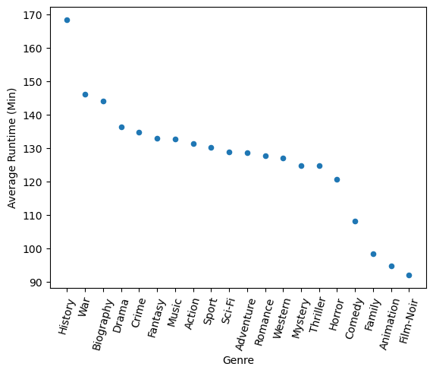
Does genre influence the runtime in the top 250?

Slide 15
Now over to PandasGUI

